Slide 1
Lecture 1
Data Structures and Algorithms

Slide 2
Description
What the course is about
This is a Theory course, not programming
  Primary focus on concepts, creating, retrieving and manipulation of data structures
  Abstract Data Types
  The basics of analysis of algorithms
  Includes coding assignments, but no programming taught
  C++ competence expected
Prerequisites
  Refresh your coding and debugging skills

Slide 3

Text Book
Data Structures & Algorithm Analysis in C++
by Mark Allen Weiss

Slide 4
Grade Composition
4 Quiz
4 Assignments
Midterm exam (20%)
Final exam (60%)
All assignments are to be your own work.
No group projects or assignments are allowed.
Exams are closed-book.
Attend all lectures!

Slide 5
What are your goals?
A step towards the BS degree
Just a requirement of CS course
Becoming a well-rounded computer scientist
Intellectual (theory) aspects of CS
Clever ideas
Interview questions at well-known software companies

Slide 6
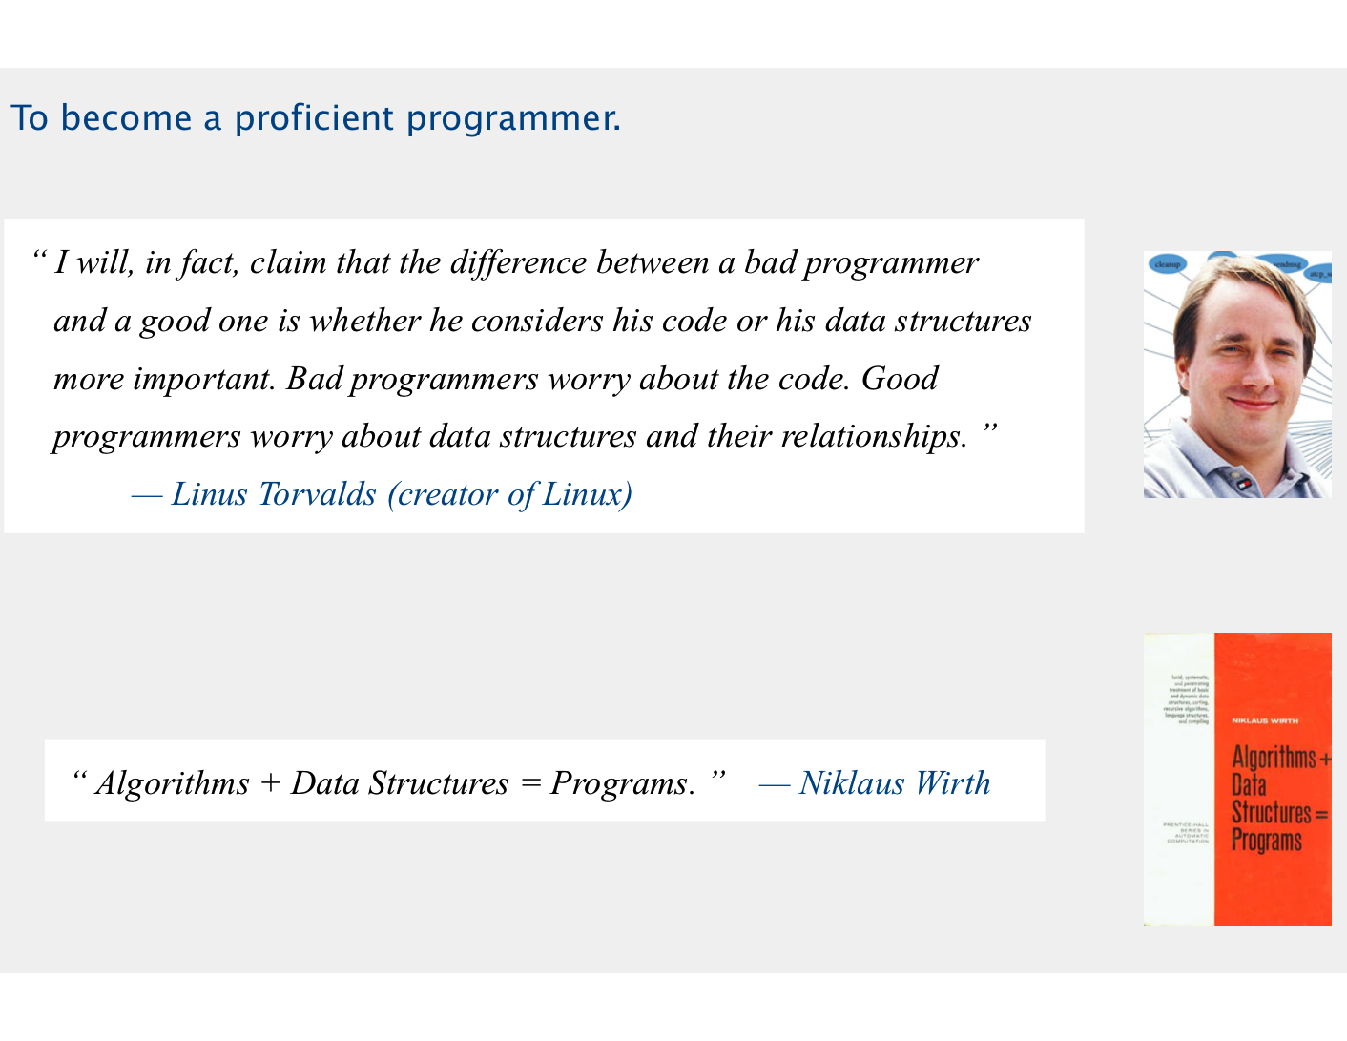
Why Study Algorithms and Data Structures?
To become better computer scientist

Slide 7

Why Study Algorithms and Data Structures?
World domination

Slide 8
Algorithms are Everywhere
Search Engines
GPS navigation
Self-Driving Cars
E-commerce
Banking
Medical diagnosis
Robotics
Algorithmic trading
and so on …

Slide 9
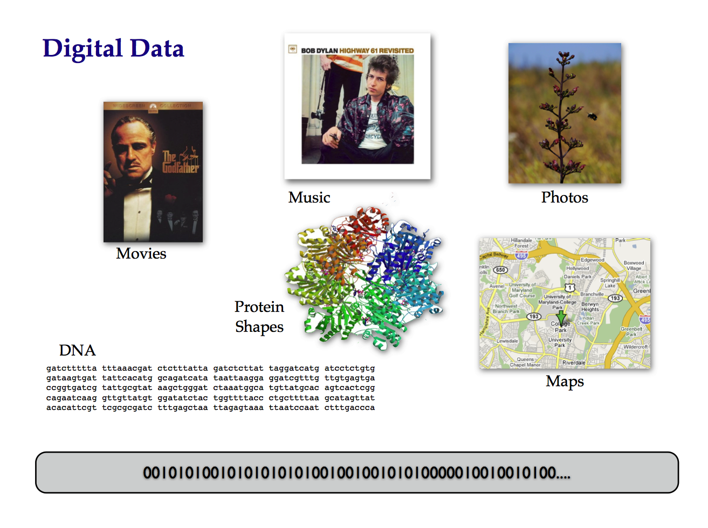
Modern World of Computing
Age of Big Data, birth of Data Science
Digitization, communication, sensing, imaging…
Entertainment, science, maps, health, environmental, banking…
Volume, variety, velocity, variability
What all happens in 1 Internet minute?

Slide 10
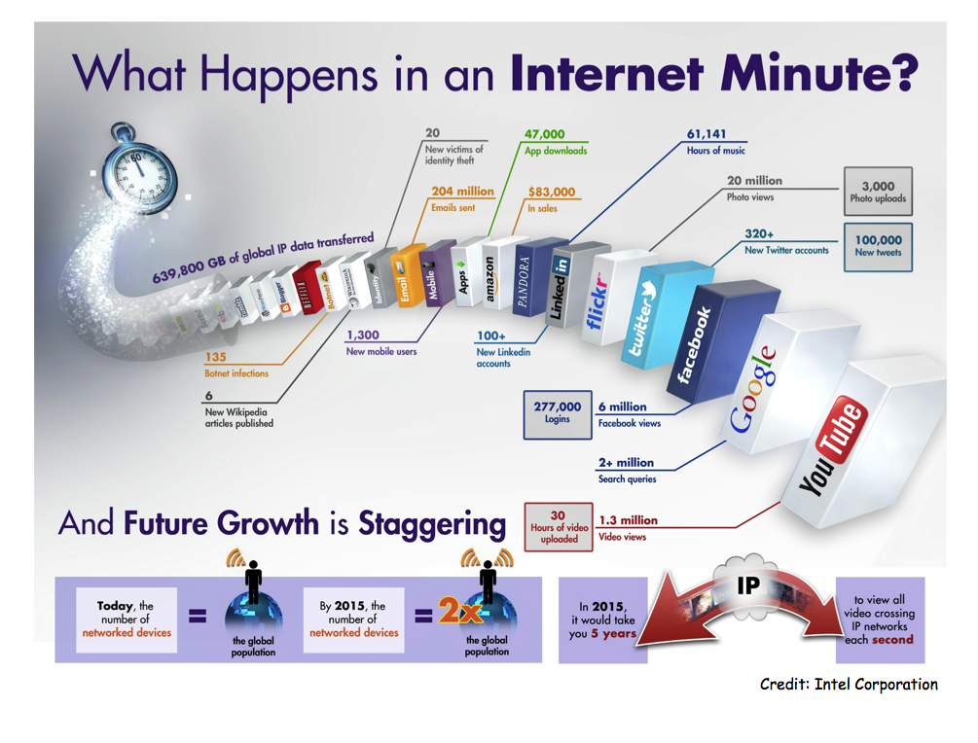

Slide 11
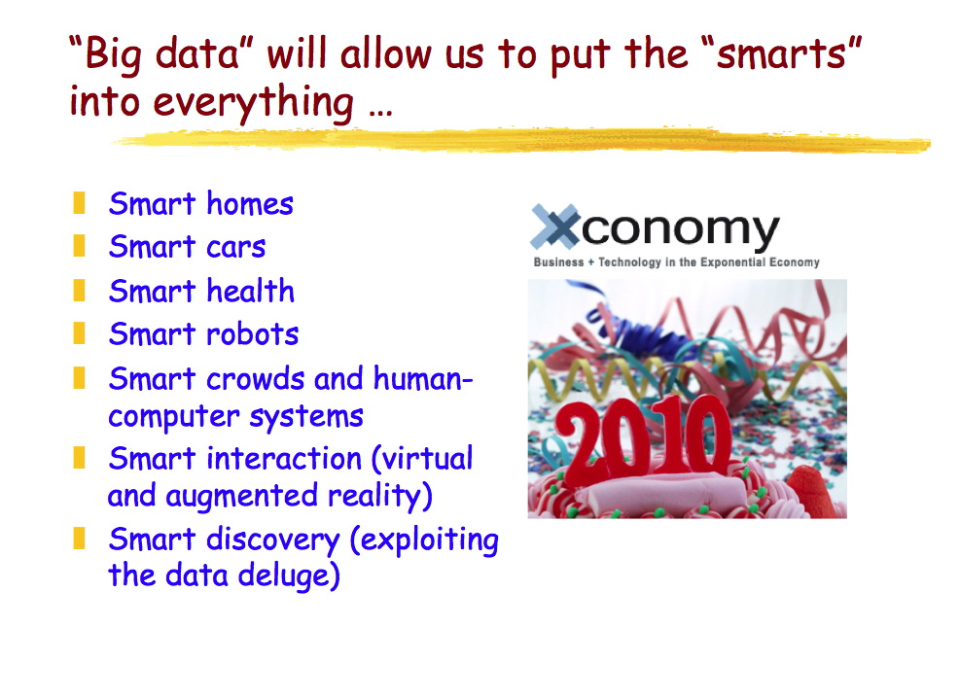
Intelligent Computational Systems

Slide 12
Why Data Structures?
Data is just the raw material for information, analytics, business intelligence, advertising, etc
Computational efficient ways of analyzing, storing, searching, modeling data
For the purpose of this course, need for efficient data structures comes down to:
  Linear search does not scale for querying large databases
  Smart data structures offer an intelligent tradeoff:
  Perform near-linear preprocessing so that queries can be answered in much better than linear time

Slide 13
Efficient Data Retrieval and Modification
Different data structures excel at different operations.
For example, an array allows for fast random access, while a linked list is efficient for insertions and deletions.
The choice of the right data structure can significantly impact the efficiency of algorithms and operations on the data.

Slide 14
Optimized Memory Usage
Data structures influence how memory is allocated and used.
Efficient memory usage is crucial, especially in resource-constrained environments.
Choosing the right data structure can help minimize memory overhead and improve overall performance.

Slide 15
Algorithm Design
Many algorithms are designed with specific data structures in mind.
For example, searching algorithms might be optimized for use with a sorted array or a binary search tree.
Efficient algorithms often rely on appropriate data structures to achieve their speed and effectiveness.

Slide 16
Code Organization and Maintainability
Using the right data structures can lead to cleaner and more maintainable code.
It helps in expressing the logical relationships within the data, making the code more readable and understandable.

Slide 17
Problem Solving
Understanding and selecting appropriate data structures are essential skills for solving a wide range of problems in computer science and programming.
It allows developers to choose the best tools for a given task, leading to more elegant and efficient solutions.

Slide 18
Foundation for Higher-level Abstractions
Data structures serve as the foundation for higher-level abstractions and data types.
They are building blocks for creating more complex structures and implementing advanced algorithms.

Slide 19
Resource Management
Data structures play a crucial role in resource management.
They help in organizing and accessing data efficiently, which is essential for managing resources like time and space.
This becomes particularly important when dealing with large datasets or real-time systems.

